Slide 1



Development of master curricula for natural disasters risk management in Western Balkan countries
WP4.1 Defining of admission requirements and enrolment of students
WP4.4 Implementation of trainings for citizens and public sector
WP4.6 Self-evaluation of trainings for citizens and public sector
Prof.dr Dženana Bijedić
University of Sarajevo
Logo of your organization
Nat Risk project meetings / 7 - 8t March 2018, Belgrade
Project number: 573806-EPP-1-2016-1-RS-EPPKA2-CBHE-JP
"This project has been funded with support from the European Commission. This publication reflects the views only of the author, and the Commission cannot be held responsible for any use which may be made of the information contained therein"

Slide 2
Activities into WP4
Development of master curricula for natural disasters risk management in Western Balkan countries
 | Activities | Year – 1 weeks | Year – 2 weeks | Year – 3 weeks
4.1 | Defining of admission requirements and enrolment of students |  | 10 | 0
4.2 | Implementation of master curricula |  | 0 | 30
4.3 | Implementation of students’ internships |  | 0 | 12
4.4 | Implementation of trainings for citizens and public sector |  | 6 | 12
4.5 | Self-evaluation of master curricula |  | 0 | 8
4.6 | Self-evaluation of trainings for citizens and public sector |  | 2 | 3

Slide 3
Description of WP 4
A.4.1
Development of master curricula for natural disasters risk management in Western Balkan countries
In this WP students will enrol to master studies in the field of risk management of natural disasters. The enrolment will be conducted according to the legal WB HEIs procedures with precise definition of the enrolment conditions.
The studies will comprise teaching, learning, exercising, evaluation and examinations. During this process students will have opportunity learn in the newly formed and equipped laboratories.
Certain number of students from each WB HEI will visit EU partner HEIs, attend lectures and compare their acquired knowledge with the knowledge and skills of colleagues from EU.
Self-evaluation on quality of master curricula will be regularly performed
To the newly enrolled students will be offered student internships at the WB partner institutions andwithin the entities from public sector.
The number of ECTS for this activity will be harmonised with international recommendation and National accreditation body rules.

Slide 4
Description of WP 4
A.4.3
Development of master curricula for natural disasters risk management in Western Balkan countries
The educational trainings will be organized for citizens and public sector in the field of risk management of natural disasters with aim to raise awareness about risks of natural disasters.
Self-evaluation of the trainings’ quality is planned.
The participants will be informed by online media and newspaper about the terms and contents of trainings.
The trainings for citizens and public sector in NDRM will be delivered in the centers for lifelong learning at universities (where it is applicable) and the certificate of acquiring the key skills in NDRM will be issued at the end of training completion.

Slide 5
Assumptions and risks related to the Iimplementation of master curricula and trainings are:
Development of master curricula for natural disasters risk management in Western Balkan countries
Assumptions:
- Students are interested in master studies in the field of risk management of natural
disasters.
- Accreditation of curricula completed.
- Representatives from public sector and citizens are interested for trainings.
Risks:
- Incompatibility of duration of master studies with the present state
- The accreditation process delays.
- The cooperation protocols with partners from public sector signed but not respected.

Slide 6
WP 4: Tasks
Development of master curricula for natural disasters risk management in Western Balkan countries
- Enrolment of students.
- Implementation of master study programmes.
- Quality monitoring of the master programmes to be conducted.
- Offering and implementation of the students' internship.
- Implementation of trainings for citizens and public sector.
Self-evaluation of the trainings.
Estimated Start Date (dd-mm-yyyy) | 15-12-2017 | Estimated End Date (dd-mm-yyyy) | 14-10-2019
Lead Organisation | UNSA
Participating Organisation | UNI, BOKU, MU, KPA, UPKM, VSUP, TCASU, UNIME, OE, UNID, RGU, TUC

Slide 7
Marketing a new master course through:
media,
social networks (fb, instagram, ...),
Info days
contacts with institutions that might be interested,....
sharing leaflets .....

Slide 8
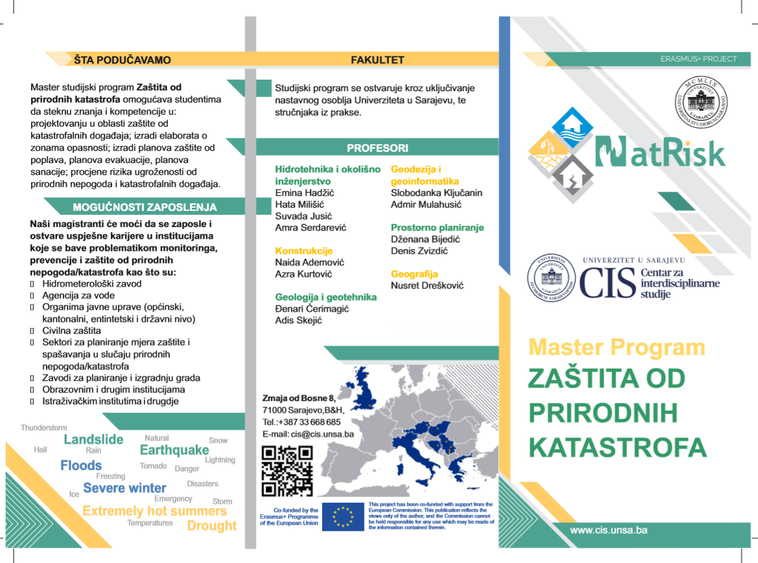
Development of master curricula for natural disasters risk management in Western Balkan countries

Slide 9
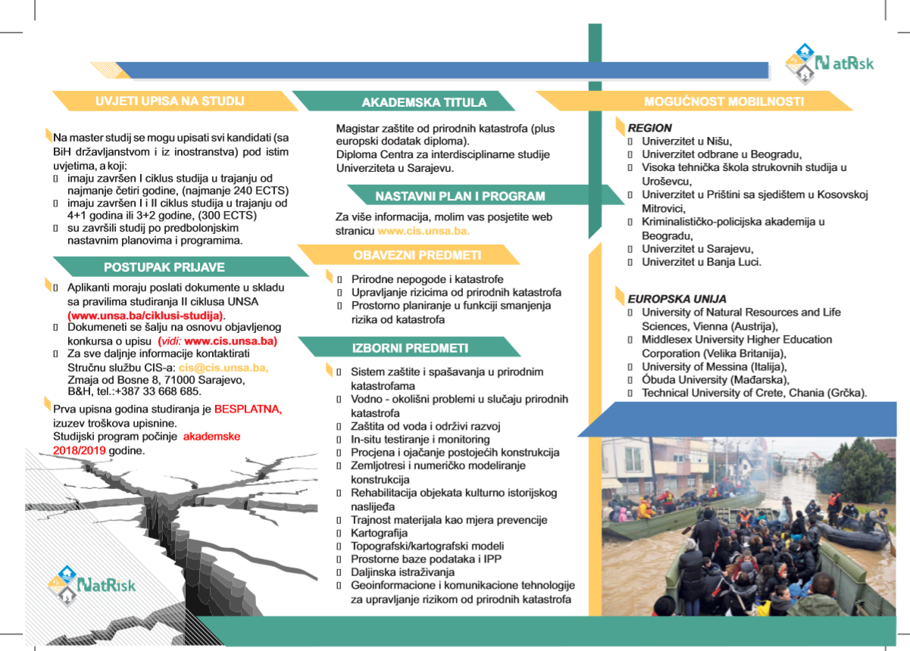

Slide 10
Call for enrolment to master studies in the field of risk management of natural disasters needs to define:
What is Protection from natural disasters and why is it imoportant?
Study duration: 2 semester
Terms of entry: min. 240 ECTS obtained prior application.
  All candidates (with BH citizenship and from abroad) will be enrolled in the master's degree progrunder the same conditions, i.e. It is required for candidates to have completed a cycle of studies of at least four years or 240 ECTS , or more and, as well candidates who have completed study in accordance to pre-bolognia principles.

Slide 11
  Title:
    Master Program Natural Disaster Protection
  Carrier:
  Centre for Interdisciplinary Studies, University of Sarajevo
  Performers:
  Teachers from UNSA faculties from different scientific disciplines
  Price:
  for the first generation of students the cost of studying is free, except for the cost of enrolment
  Diploma obtained / Academic title and professional title:
  Master of protection from natural disasters

Slide 12
APPLICATION PROCEDURE
The official call for applications and submission of documents will be published on 4 September 2018 in accordance with the Academic Calendar of the University of Sarajevo and run until September 30, 2018. Signing up for a master's program can be done online, and submitting documents to the Interdisciplinary Study Center.

Slide 13
Requested documents:
The original diploma and the diploma supplement (for students who completed the Bologna study) or a nostricificated diploma for candidates who did not complete the previous study in Bosnia and Herzegovina
CV
Motivation letter
Birth certificate
Citizenship Certificate
Other relevant documents

Slide 14
All information about a new mater course should be published on web site of University – short version, six pages
NatRisk_master program_Osnovni podaci_UNSA_mart 2018.doc
A brochure - about 20 pages on master program, will be prepared.

Slide 15
Deliverables/results/outcomes
Development of master curricula for natural disasters risk management in Western Balkan countries
Work Package and Outcome ref.nr | 4.4. Implementation of trainings for citizens and public sector
Title | Participants trained
Type | ☐ Teaching material ☐ Learning material ☐ Training material | ☐ Event ☒ Report ☐ Service/Product
Description | Trainings (2 day) will be held in WB partner HEIs and conducted by experts from WB partners (2 trainings per partner institution).Foreseen number of trainees 30 per training.
Due date | 14-09-2019
Languages | RS, BA, EN

Slide 16
Development of master curricula for natural disasters risk management in Western Balkan countries
Deliverables/results/outcomes
Work Package and Outcome ref.nr | 4.6. Self-evaluation of trainings for citizens and public sector
Title | Quality report on trainings
Type | ☐ Teaching material ☐ Learning material ☐ Training material | ☐ Event ☒ Report ☐ Service/Product
Description | After conducted training, questionnaire fulfilled by the trainees will serve as a source for report. Created report on training quality. The obtained results will be used to improve future trainings. After training is necessary to obtain evaluation of training
Due date | 14-09-2019
Languages | RS, BA, EN

Slide 17
Thank you for your attention!

